Slide 1
Architecture design and Code analysis for Customer purchasing pattern

Slide 2
agenda
Architecture Design
Visual Analysis
Area of improvement

Slide 3

Architecture Design

Slide 4
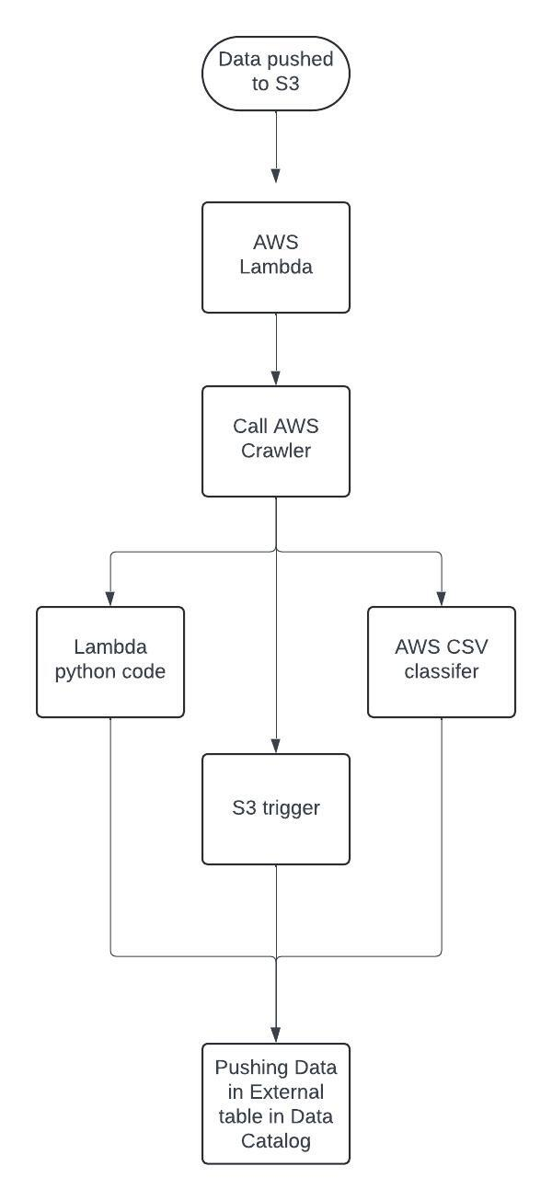
Architecture Diagram For AWS Crawler

Slide 5
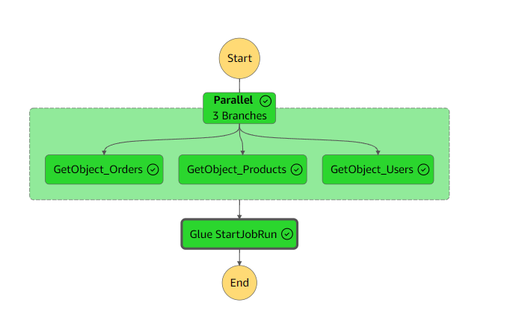
Architecture Diagram For AWS GLUE(Step Function)

Slide 6

Visual analysis

Slide 7
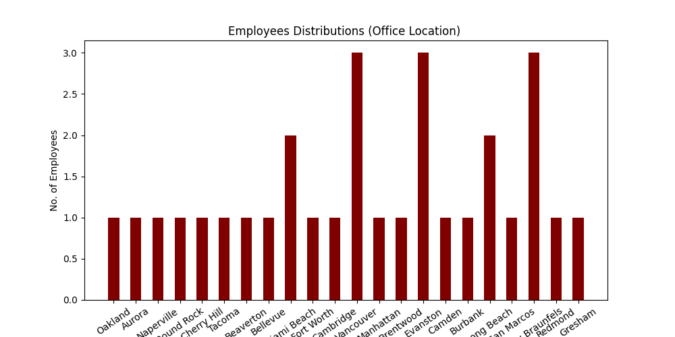
Employees distributions(office location)

Slide 8
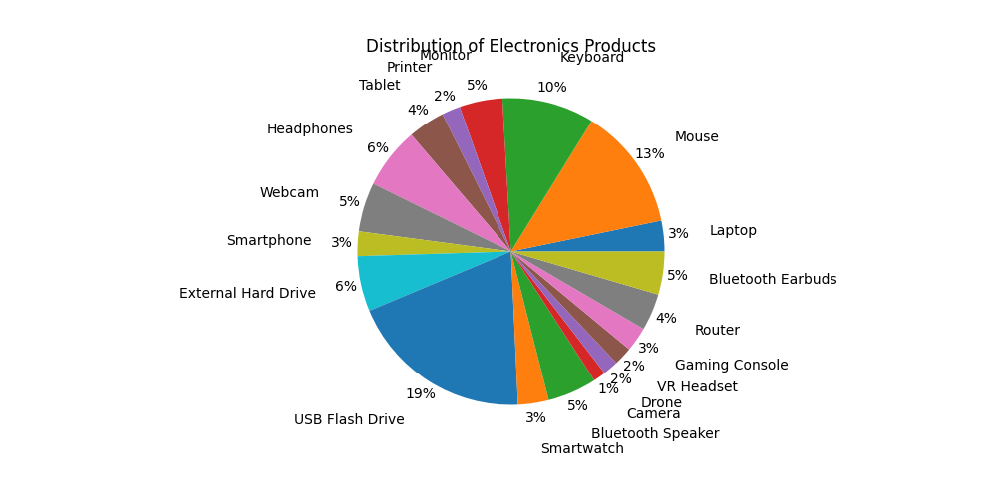
Distribution of electronics products

Slide 9
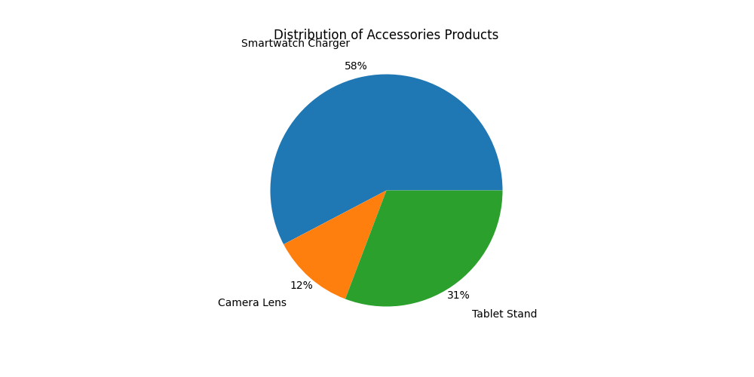
Distribution of Accessories products

Slide 10
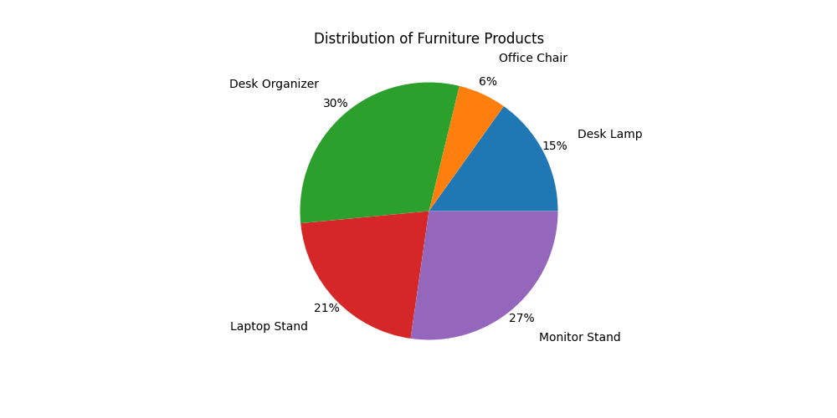
Distribution of furniture products

Slide 11
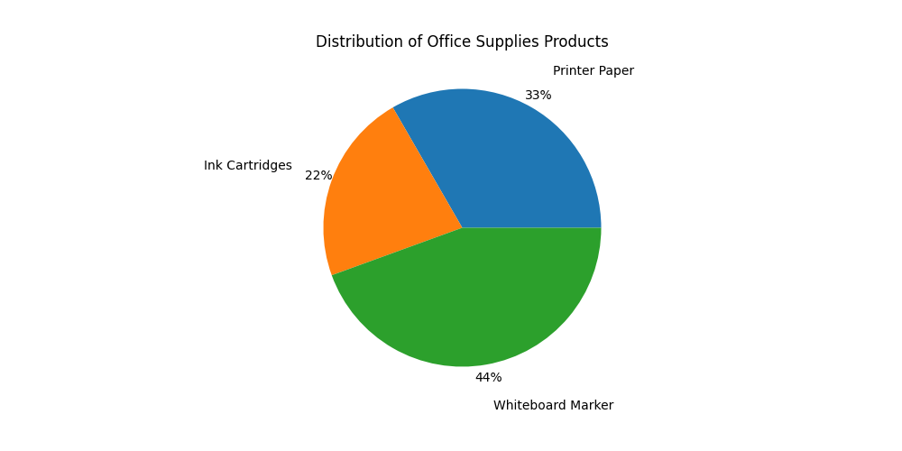
Distribution of office supplies products

Slide 12
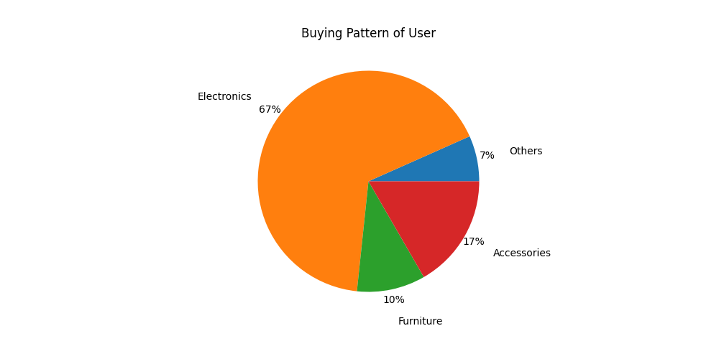
Buying pattern of user

Slide 13
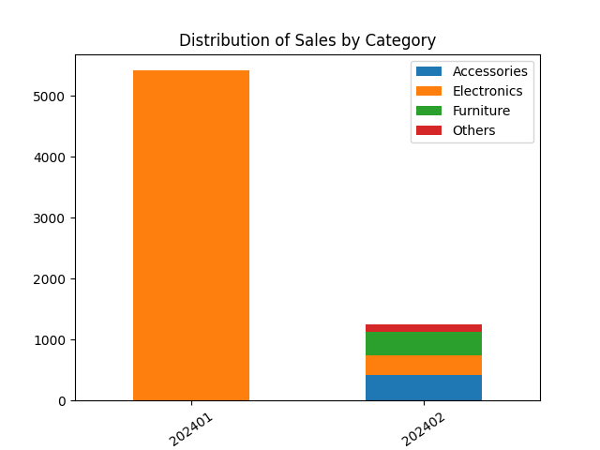
Distribution of sales by category

Slide 14
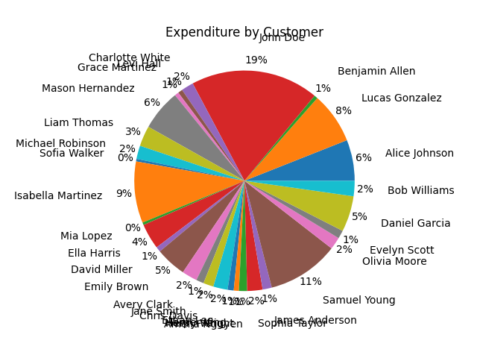
Expenditure by customer

Slide 15
Area of improvements
The whole process can be automated by using AWS Step function or Airflow.
The data can be moved to AWS redshift for taking the database like features.

Slide 16

Important link
Github code link https://github.com/sumanh458/AWSCodingChallenge/tree/main

Slide 17
Thank you
Suman Haldar
+91 7008370068
sumanh458@gmail.com
Linkedin Profile: https://www.linkedin.com/in/suman-haldar-55986674/

